Slide 1
Community ART for Retention in Zambia:
Health Economics Evaluations
Centre for Infectious Disease Research in Zambia (CIDRZ)
In partnership with the Zambian Ministry of Health
Sponsor: Bill & Melinda Gates Foundation
19th September 2018
Collaborators: James Cooke University, Johns Hopkins, UAB, UCSF, UNZA

Slide 2
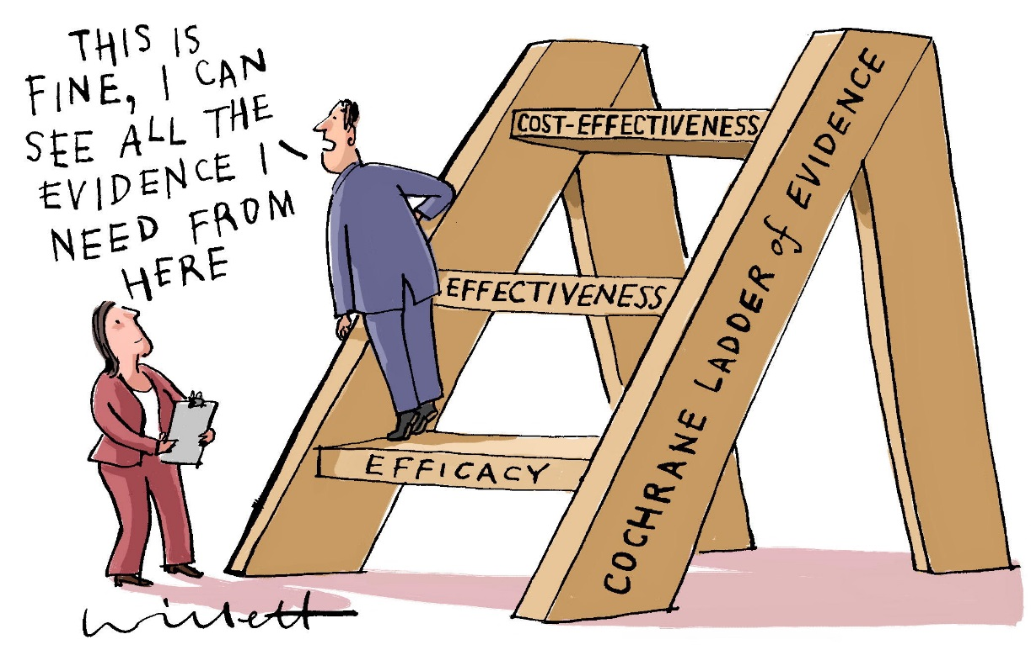
Evaluating Effectiveness, Efficiency and Cost-Effectiveness of Differentiated Service Delivery for HIV Care
Time and motion analysis of routine ART clinic service delivery
Routine ART services costs in 10 public ART clinics in Zambia
CommART program healthcare worker workloads and service delivery costs
Notes:
The CommART study had three main objectives: (1) To determine the acceptability, appropriateness and feasibility of a differentiated care systems in Zambia; (2) To evaluate the effectiveness, efficiency and health care quality of differentiated care and (3) To develop a toolkit for assessment of local needs and preferences
This presentation focuses on activities that were done to achieve objective 2.
1. Efficacy – Can DSD models work under ideal circumstances?
2. Effectiveness – Do DSD models work in clinical practice: under usual circumstances?
3. Cost effectiveness – Are DSD models worth implementing: what is the effect of DSD models in relation to the resources they consume?

Slide 3
Background
On a global scale, declining prices of ARV regimens has made HIV treatment more affordable
Additionally, the WHO recommendations to expand ART eligibility has doubled the number of patients initiated on lifelong treatment worldwide
In Zambia, 671,066 adults and children were receiving ART services from only 592 clinics in 2014 (Ferrihno, 2011 & MoH, 2014)
Massive scale up has taken place in the context of limited infrastructure and human resources, resulting in clinic inefficiencies (Were et al, 2015)
Notes:
1.
2. The WHO’s recommendation to expand ART eligibility to include all HIV positive individuals regardless of WHO clinical staging and CD4 cell count has led to massive uptake of ART worldwide.
4…such as critical human resource shortage, increased workloads, congestion, limited patient-clinician interaction. If inadequacies are not addressed, they may have long term effects on HIV treatment. There is opportunity for improvements these inadequacies.

Slide 4
Background
Time appointment systems can result in time savings and increased economic productivity (Kwena et al, 2014)
WHO ART guidelines include recommendations for differentiated service delivery (DSD) frameworks to improve coverage, quality, and adherence
There is little empirical research detailing the operational workflow of clinical staff and time distribution of patient visits in ART clinics, neither is there evidence of the cost of implementing DSD models in Zambia
Notes:
2. In the recent past, the WHO ART guidelines have recommended DSD models to improve coverage, quality and adherence
3. In Zambia, there is a dearth of knowledge on operational workflow of staff in ART clinics, distribution of patient visits and cost of implementing DSD models.

Slide 5
Aims of the CommART Economic Evaluations
Understand potential workflow inefficiencies
Estimate staff time distributions
Use results time-and-motion analysis to better inform other economic costing activities
Time and Motion Analysis
Derive top down and bottom up ingredients-based costs
Examine the relationship between clinic characteristics and per-patient costs
Current Costs of Routine ART Care in Zambia
Differentiate resource mobilization for research, implementation & operations
Assess human resource needs for each DSD model
Workload & Costs Analysis of DSD Models
Notes:
1. Firstly, we sought to understand the operational characteristics of ART clinics in Zambia using a work measurement technique for systematically observing, analyzing and recording times of performing specific tasks (in this case ART clinic tasks)
e.g. of workflow inefficiencies = wait time and congestion issues
2. Secondly, we wanted to estimate current costs of routine ART care in selected clinics in Zambia
Tom-down approach determines unit cost by deriving the total cost of providing services based on past expenditure and then
Bottom-up approach considers all inputs used to provide a service
3. Thirdly, we aimed at assessing workloads and time commitment for CommART field staff and apportion costs to research, implementation and operations activities

Slide 6
Components of Cost Assessments
Cost Category | Costs Collected
Patient costs | Opportunity costs (including waiting time), transportation to and from clinic
Program costs | Costs of setting up M&E framework, technical support, staff meetings and trainings, salaries and incentives
Provider & central system costs | Costs of ARV and other essential drugs, equipment, laboratory tests and supplies, other consumables, administrative and overhead costs
Notes:
To be able to achieve the outlined objectives, we needed to determine what kind of costs to collect. Costs were therefore categorized into patient, program and provider costs.

Slide 7
Methods: Time and Motion Analysis
Purposively sampled 10 out of 26 clinics ART clinics based on geography, patient volume and retention
Conducted TAMs for HCW and patient
TAM data collection teams consisting of 4-6 people
Observed adherence counselors, clinical officers, nurses and pharmacy technologists
Staff TAM Data Form
Notes:
1. Generally, the costing studies were planned along side the study. Sites were selected after the main study sites had started implementing differentiated models for HIV care
3. We assigned codes for identified clinic activities that were going to be observed, including; counseling, clinician, triage, pharmacy.

Slide 8
Methods: Costs of Routine ART Care
All costs were evaluated for the year 2016
Used a bottom-up approach to collect health system costs except for drug and laboratory costs which were collected using a top-down approach
Costs were categorized into six elements:
  Building overheads, drugs, supplies, laboratory and staff costs
Costs were distributed across triage, clinic, counseling, pharmacy and laboratory visits, and administrative and other activities

Slide 9
Methods: Workload and Cost Analysis of DSD Models
Workload survey to assess workload and time commitment for field staff
Used a top-down approach to extract costs from public and CIDRZ financial records
Study database provided information on patient participation and helped to allocate costs to DSD models
Categorized study phases into enrolment, early operations, operations and exit to apportion study expenses accordingly
Used provider perspective to evaluate costs and expressed derived costs as 2016 US$

Slide 10
Results: Time and Motion Analysis

Slide 11
Distribution of Clinical Staff Time by Service
Key Clinical Activity Groups | Counselors (n=53) |  | Clinical Officers (n=10) |  | Nurses (n=31) |  | Pharmacy Tech (n=10)
 | Time per Patient in minutes | Percent Daily Time | Time per Patient in minutes | Percent Daily Time | Time per Patient in minutes | Percent Daily Time | Time per Patient in minutes | Percent Daily Time
 | (1Q, 3Q) |  | (1Q, 3Q) |  | (1Q, 3Q) |  | (1Q, 3Q)
Counseling | 4 (2,7) | 32% | - | - | 3 (1.5,4) | 0% | - | -
Clinical Visit | 2 (2,4) | 12% | 3 (2,5) | 79% | 3 (2,4) | 45% | - | -
Pharmacy | 3 (2,4) | 3% | 3.5 (2,5) | 1% | 1 (1,2) | 1% | 2 (1,2) | 57%
Lab | - | - | - | - | 4 (3,5) | 9% | - | -
Administrative** | 5.8 | 34% | 0.1 | 2% | 4 | 18% | 3 | 20%
Other** | 3.6 | 21% | 0.9 | 19% | 5 | 27% | 3 | 23%
Notes:
We observed 53 counselors, 10 clinical officers, 31 nurses and 10 pharmacy technologists and noted that direct interaction time per patient lasted <5 minutes per encounter
Counselors - 4 minutes per patient
COs and nurses spent 3 minutes per patient
Pharmacy Technologists spent 2 minutes.

Slide 12
Daily Activity Distribution by Health Care Worker
Notes:
Figures show distribution of time spent per hour on direct patient interaction, administrative work, and other activities by four types of HCWs. On average, clinic staff spent 3-4 hours working in the ART clinic.
Pharmacy technologists worked for an average of 3.9 hours, Counselors and clinical officers spent 3.2 hours while nurses spent 2.9 hours working in the ART clinic. Of note is that nurses, particularly those in rural areas, also spent part of their time providing services in other departments within their designated health facility.
Direct patient interaction (counseling, drug pick up, clinical and laboratory visits) accounted for the most substantial time for each staff with peak times observed from 9AM to 12PM. Administrative tasks followed a similar but less pronounced trend.

Slide 13
Duration of Patient Visits: Urban vs Rural
Notes:
We observed that large volumes of patients arrive between 5AM and 7AM and wait the longest to get a service.
Duration of clinic visit decreases as the number of patients throughout the day falls, implying shorter wait times and faster service.
From the patient’s perspective, we observed that individuals spent a median of 239 minutes in the ART clinic. Median visit length ranged between 232 and 253 minutes for urban and rural clinics respectively. Patients receiving clinical services at rural sites stayed on for an average of 24 minutes as compared to 40 minutes at an urban site.

Slide 14
Limitations: Time and Motion Analysis
TAM data collection was conducted only once per clinic
At some sites, patient TAMs started after patients had arrived to access ART services
The short per-patient direct interaction are due to operational and patient-level factors which were not evaluated
Notes:
Our study results should be interpreted with some care as the methodologies and the data have several key limitations.
3. Patient to staff ratio, patient’s motivation for arriving before clinic opening times, etc.

Slide 15
Conclusions: Time and Motion Analysis
Patients experience limited interaction with clinic staff with most interactions lasting less than 5 minutes
Clinic staff spend between 20% and 53% of their time performing administrative and other non-patient activities
Differentiated models for delivery have potential to address some clinic inefficiencies
Notes:
Inconsistencies in clinic efficiency throughout the day driven by increased congestion due to regular early morning high patient volumes may suggest the need for time appointment systems.

Slide 16
Results: Current Costs of Routine
ART Care in Zambia

Slide 17
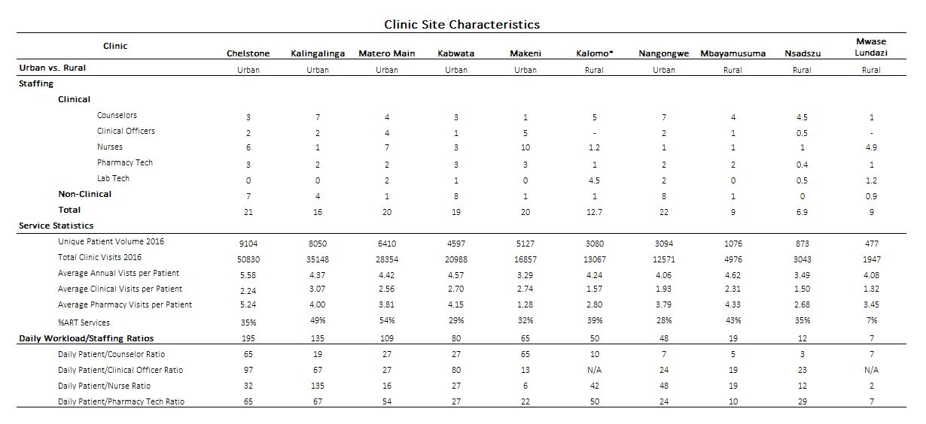

Slide 18
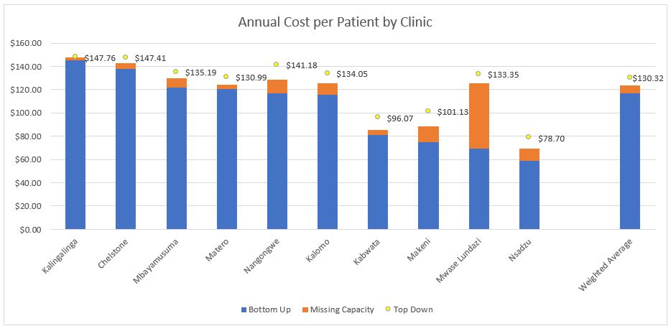
Annual Cost per Patient by Clinic
Notes:
The average per-patient annual cost of ART services was $116.69 (Range: $69.19-$145.44) for bottom up costing and $130.32 (Range: $78.70-$147.76) for top down costing methods.
Average missing capacity costs was $6.85 (Range: $2.51 – $56.42)
ART drug costs are the main cost driver (accounting for 67%-87% of all costs) contributing on average $86.23 (Range: $40.02-$127.23) per year and highly sensitive to the types of patients included in the analysis
Variability in costs across the 10 clinics was associated with operational characteristics, capacity, and workloads

Slide 19
Limitations: Current Costs of Routine
ART Care in Zambia
A small sample size of clinics making it difficult to evaluate confidence intervals in costs and run regressions
Additionally we do not have clinic characteristic variables assessed over time making it difficult to assess how changes in these characteristics may contribute to per patient costs through regression
Our costs are primarily assessed as the aggregate of costs and operational factors in the ten clinics included in this study making it difficult to assess within clinic cost variabilities resulting from day-to-day differences in clinic operations
Notes:
Some limitations include:

Slide 20
Conclusions: Current Costs of Routine ART Care in Zambia
Cost estimates are highly sensitive to methods and data considered in the analysis
Our study provides and empirical basis for transparently evaluating ART costs in low resource settings
With rapidly changing operational landscapes, global markets, and public health guidelines, service delivery costs should be consistently and continuously monitored to allow for effective monitoring and evaluation.
Notes:
Real-world costs of current routine ART services in Zambia are considerably lower than previously reported studies largely due to reductions in drug costs
This observed variability should be carefully assessed in the most transparent manner when planning and projecting health economic impact

Slide 21
Results: Workload & Costs of CommART models

Slide 22
Total Person-Hour Per Patient by DSD Model
Notes:
Lay Health Care Workers (LHCW) and Community Liaison Officers (CLO) reported spending an average of 13% and 15% of their total person hours on routine clinical work during slow research and programme activity periods.
LHCWs also reported the most amount of overtime work at 16% compared to 6.5% and 1% of overtime work reported by CLOs and Pharmacy Technologist (PT) respectively.

Slide 23
Translating workloads into costs
Human resource costs (cost per PSY)
Notes:
Based on average CIDRZ salary support for the three on-site personnel types, total direct personnel cost was largest for UAG, followed by CAG, FT, and START.
When we factored in the number of patients active in each model, unit cost per Person Service Year was largest for FT at $45.73, followed by UAG ($37.39), CAG ($24.53), and START ($5.20).
When substituting government salary levels for similar types of personnel (mainly for CLO and PT at $1.78 and $2.78 per hour), total unit cost (per PSY) were lowered to $22.04, $20.81, $20.29 for FT, UAG, and CAG models.

Slide 24
Overall Cost of CommART models per PSY

Slide 25
Discussion
Costs of each service model was most sensitive to salary levels of pharmacy technologist
Notes:
Overall model costs were calculated using top-down costing of the total DSD model operation cost per patient service year (PSY) by model type to include direct personnel, overhead and operations, and supervision & training costs.
Our preliminary cost analysis results of the DSD models in the CommART study suggest that the three DSD model operations costs are higher compared to the annual routine ART visit costs at $43.22 (Range $20.53 – $103.25). Given the DSD models in our CommART study indicates positive benefits to the patient adherence and care, additional analyses are currently being planned to evaluate the cost-effectiveness of the DSD models in the CommART study.

Slide 26
Conclusions: Workload & Costs of CommART models
Fully align our routine ART cost with the CommART program costs (inclusion of ART drug and routine clinic visit costs)
Assessment of factors influencing uncertainties (i.e. cost drivers of each model)
Cost-Effectiveness Analysis
  Align our analyses with that of primary effectiveness studies from CommART study team
  Model various measures of adherence into health outcome estimates (e.g. death/DALY averted) to compute incremental cost effectiveness ratio (ICER) to be measured against varied levels of willingness to pay

Slide 27



Thank You
We would like to thank the Zambian Ministry of Health and all participating patients and health workers.

